Slide 1
19CSE 202 DBMS FINAL REVIEW TIMETABLE MANAGEMENT SYSTEM
Team Members:
S.No | Reg.No | Name of the Student | Role
1 | CB.EN.U4CSE19105 | AVVLN BALARAM | DESIGNER
2 | CB.EN.U4CSE19135 | NDN JAHNAVI | LEADER
3 | CB.EN.U4CSE19148 | SITHARA J P | DEVELOPER
4 | CB.EN.U4CSE19154 | TULASI SAI JAYANTH | DOCUMENTATION AND TESTING

Slide 2
PROBLEM DEFINITION
TIMETABLE MANAGEMENT SYSTEM
Every university desires to have a software which generates time table easily . So The main objective of developing this system will have a feasible and quality time table for students and faculties. Another objective is to make the system user-friendly and easy to maintain. The system produced should be flexible enough that it can be modified in future if any form of update should be done .

Slide 3
MOTIVATION
NEED OF THE PROJECT:
The system creates an error-free and clash free timetable thereby saving time and effort. Assign teachers and classrooms for lectures and optimize allocation of resources in the best manner possible.
END USERS :
The end users are Faculties, students and the administrators of the institution.
END PRODUCT:
The end product is a web application
HOW IS IT USEFUL:
The students and the faculty of the institution can easily access their timetables.
The system can be fully customized to meet the unique class scheduling needs and suggestions of the institution.

Slide 4
FUNCTIONALITIES
Generate multiple timetables
Conflict free timetables
Vanquishes human errors
The details of students and faculties are stored in database
Time to time rearrangements

Slide 5
MODULES
The project mainly has five modules:
LOGIN: In this module faculty and students can access their timetable using their credentials.
ADMINISTRATOR: All the operations related to timetable are managed like time slots are divided properly by sessions.
FACULTY: It has been managed by the courses which is assigned to them. STUDENTS: It has been managed for students on the basis of the courses registered by them.
CLASS: It is used to manage the class and lab sessions by giving priority to time slots.

Slide 6
Software/Tools Used
CREATELY – ER & EER Designing
HTML, CSS, JavaScript - Front End
PHP- Back End
Sql - Database
XAMPP - Designing

Slide 7
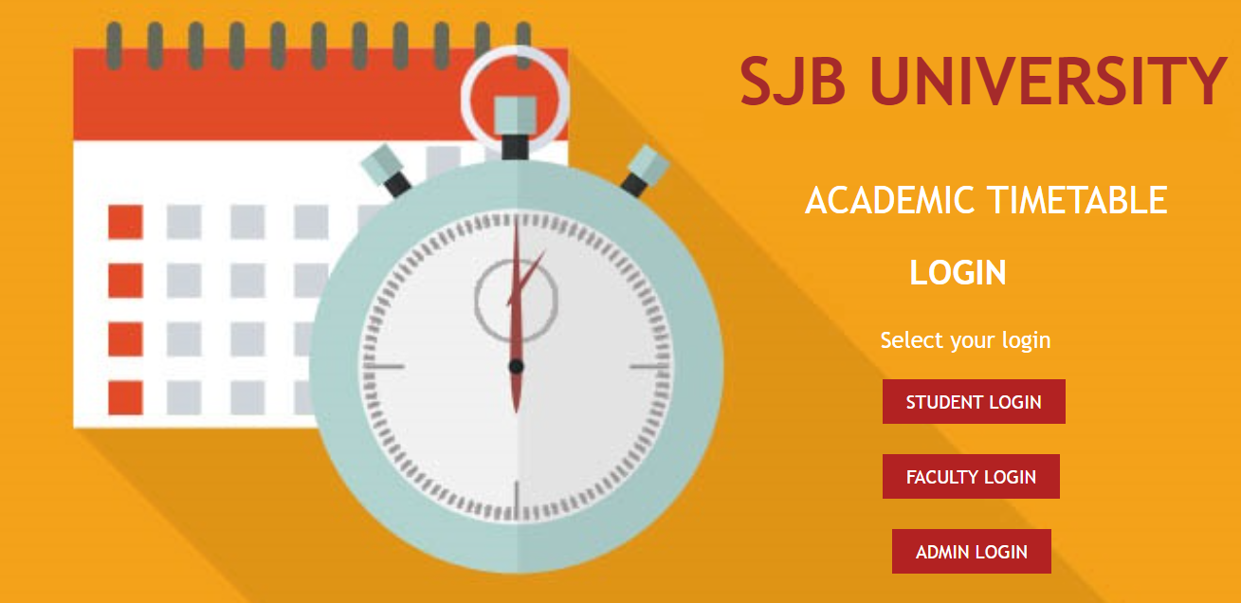
UI SCREENSHOTS

Slide 8
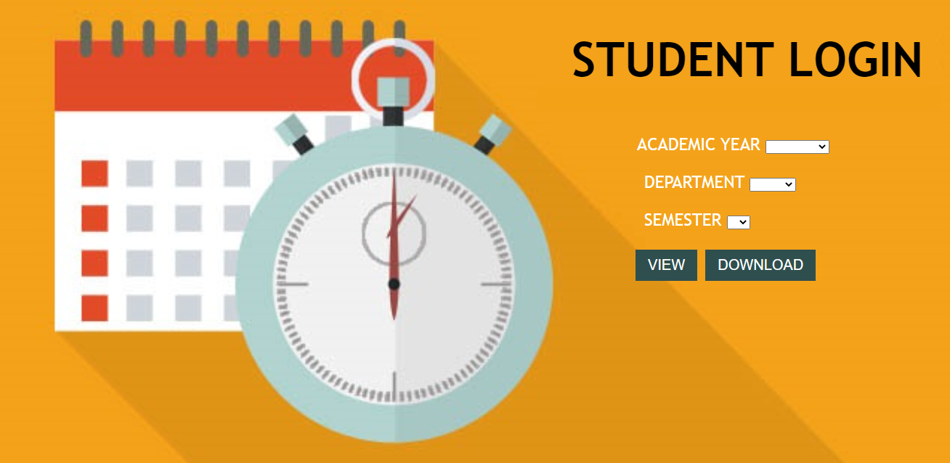

Slide 9
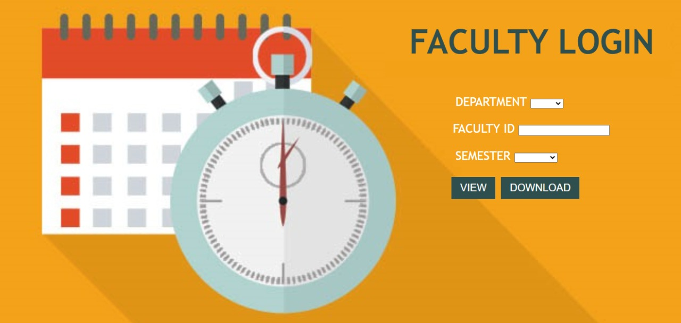

Slide 10
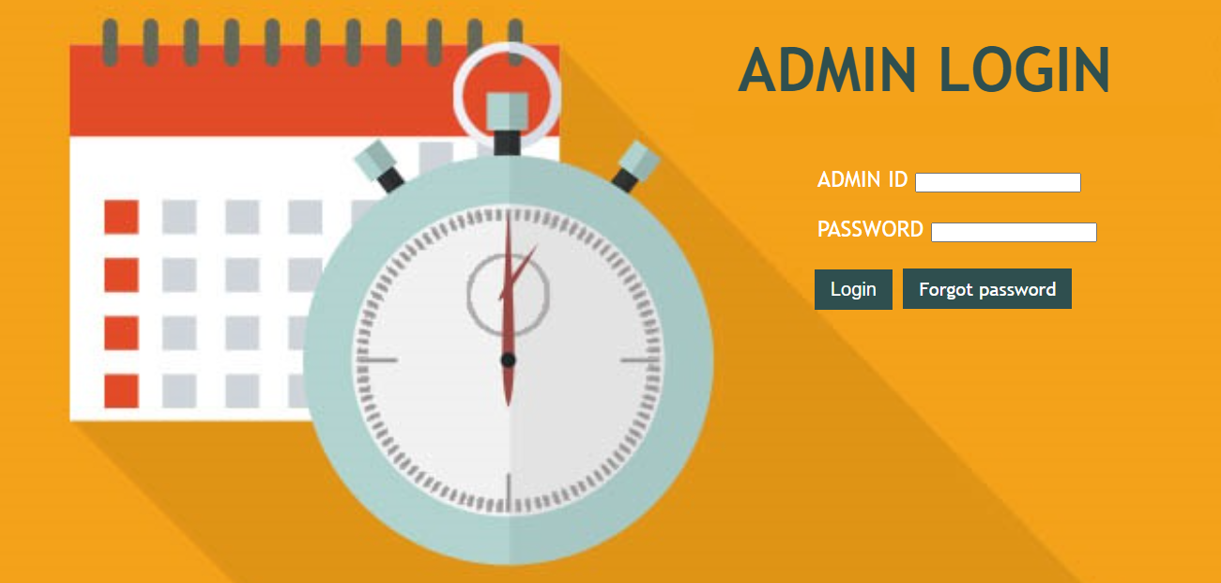

Slide 11
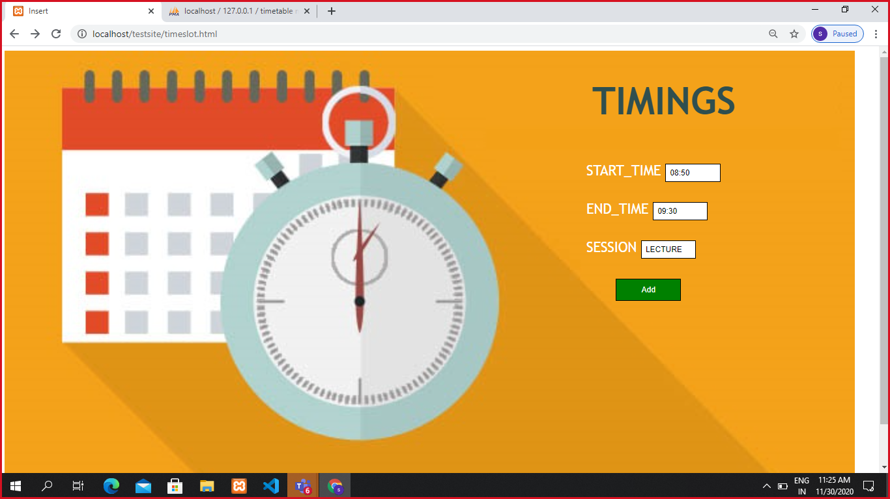
DEMO

Slide 12
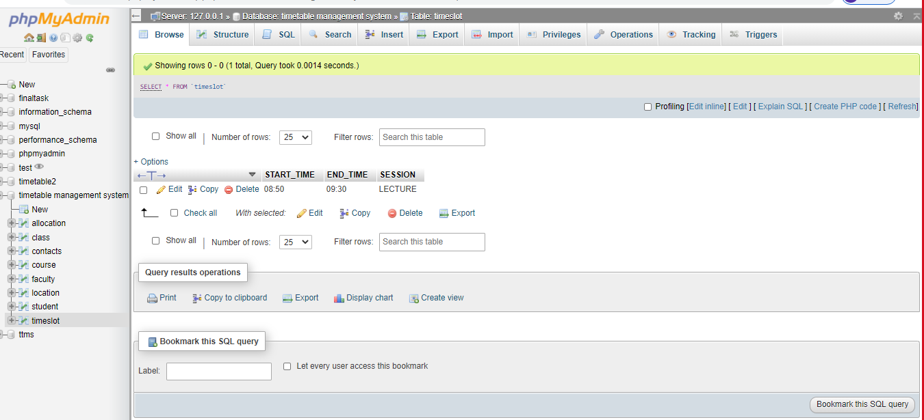

Slide 13
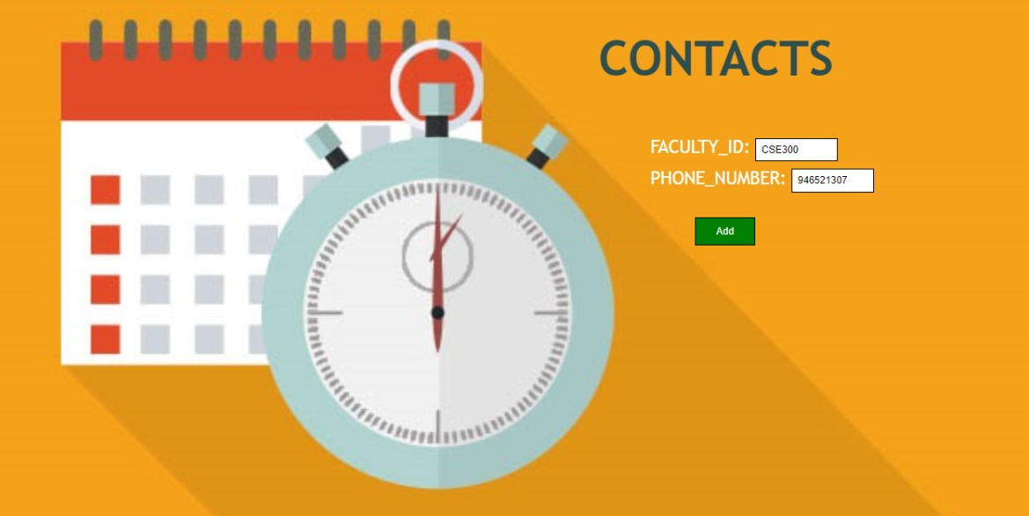

Slide 14
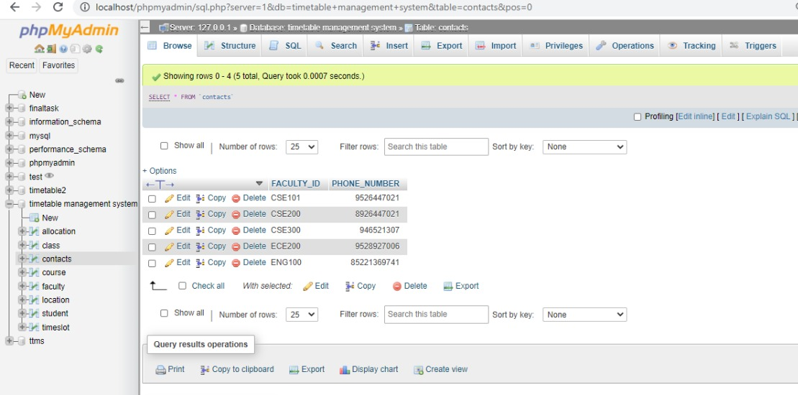

Slide 15
CONCLUSION
Through this project, we learnt how to convert a theoretical problem statement into implementation by considering all the hurdles to be overcome when it comes to a real time project.
We also learnt about the connection of database with the servers and web pages and retrieval of data. This web application is used to access student and faculty timetable and also the admin can update the database and generate timetable .This application makes it easier. Students can view their classes respective timetables. Time and effort will be less.

Slide 16
REFERENCES
ER diagram:
https://creately.com/blog/diagrams/er-diagrams-tutorial/#:~:text=How%20to%20Draw%20ER%20Diagrams%201%20Identify
%20all,attribute%20names%20so%20they%20can%20be%20understood%20easily.
EER diagram:
https://www.tutorialride.com/dbms/enhanced-entity-relationship-model-eer-model.htm
Normalization :
https://beginnersbook.com/2015/05/normalization-in-dbms/
Back end :
https://www.javatpoint.com/php-mysql-login-system

Slide 17
THANK YOU

